Slide 1
Design Pattern QP Solutions
Samin Sharaf Somik
Lecturer, Dept. of CSE, UIU

Slide 2
Disclaimer
This slide contains all the solutions from the past question papers for the Design Pattern problems
Try out the problems on your own first, and then check your answers with the solutions

Slide 3
Spring 26
1. Design UML diagrams using the appropriate design pattern for the following scenarios: [CO2] [4 Marks]
(a) IntelliWrite is an AI-powered writing assistant used for drafting emails, reports, and social media posts. The application supports multiple text generation modes, including Professional Writing, Creative Writing, and Technical Writing. Users can switch between these generation modes at runtime depending on their needs. The system should allow additional writing modes to be added in the future without modifying existing code.

Slide 4
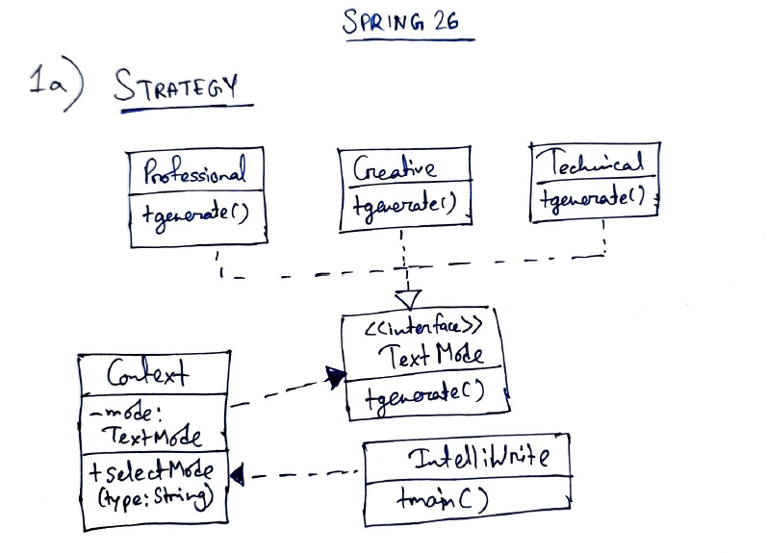
Spring 26

Slide 5
Spring 26
1. Design UML diagrams using the appropriate design pattern for the following scenarios: [CO2] [4 Marks]
(b) IntelliWrite interacts with language models via the standard LLMService interface for text generation. The system was originally designed to work with OpenAI’s GPT service. The team now wants to integrate Anthropic’s Claude as an additional AI provider. Since Claude uses a different request and response format, the team must ensure that the new providers’ format works seamlessly with the existing application without modifying IntelliWrite’s internal code.

Slide 6
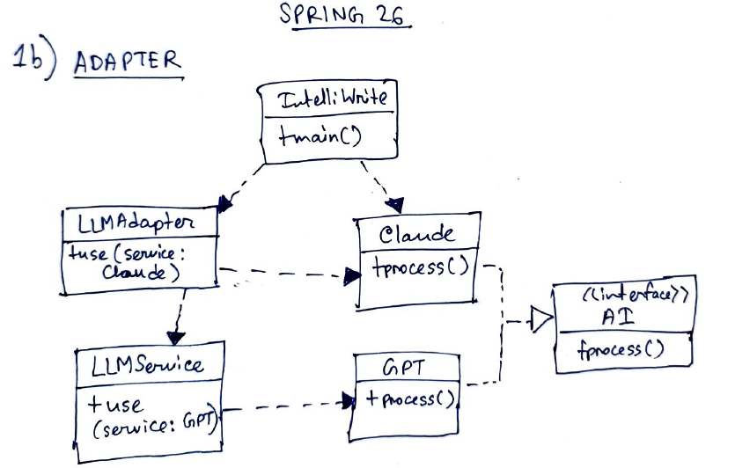
Spring 26

Slide 7
Fall 25
1. Design UML diagrams using the appropriate design pattern for the following scenarios: [CO2] [4 Marks]
(a) FitRide is a fitness application that allows users to track their workouts. The app supports various workout calculation techniques, including calorie-based, time-based, and distance-based workouts. A user can switch between these workout calculation techniques at runtime depending on their fitness goal. The application should allow adding new workout calculation techniques in the future without modifying existing code.

Slide 8
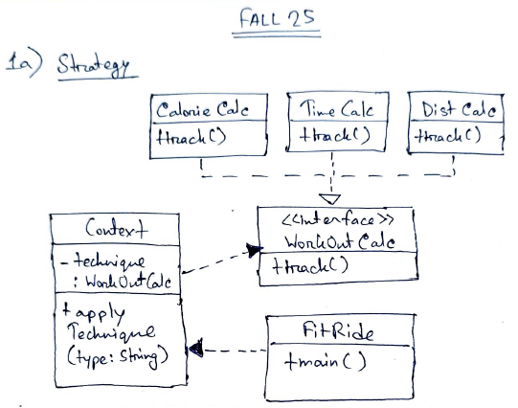
Fall 25

Slide 9
Fall 25
1. Design UML diagrams using the appropriate design pattern for the following scenarios: [CO2] [4 Marks]
(b) UniPay is a university-wide online payment system used for tuition fees, examination fees, and library fines. To avoid data inconsistency and transaction conflicts, the system must ensure that only one instance of the payment manager exists throughout the application lifecycle. All payment requests from different modules must be handled through this single instance.

Slide 10
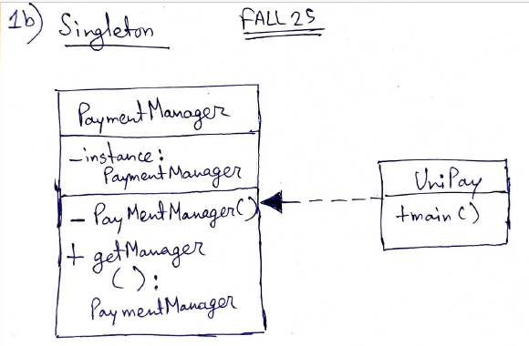
Fall 25

Slide 11
Summer 25
1. Design UML diagrams using the appropriate design pattern for the following scenarios: [CO2] [4 Marks]
(a) SkyByte manufactures drones for three models: Falcon, Hawk, and Eagle. Each model has a distinct Camera System and Propulsion Unit. Falcon uses a 4K UltraCam with a TurboJet Propulsion, Hawk uses a ThermalCam with a QuadCopter Propulsion, and Eagle uses a NightVisionCam with a Hybrid Rotor Propulsion.

Slide 12
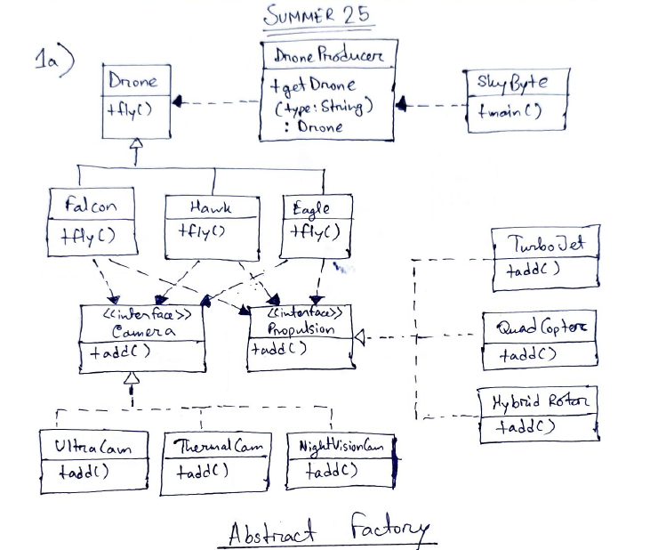
Summer 25

Slide 13
Summer 25
1. Design UML diagrams using the appropriate design pattern for the following scenarios: [CO2] [4 Marks]
(b) SkyByte allows users to enhance drones with add-ons like Auto-Return System, Obstacle Avoidance, and Live Tracking Module. These add-ons can be attached independently to any drone.

Slide 14
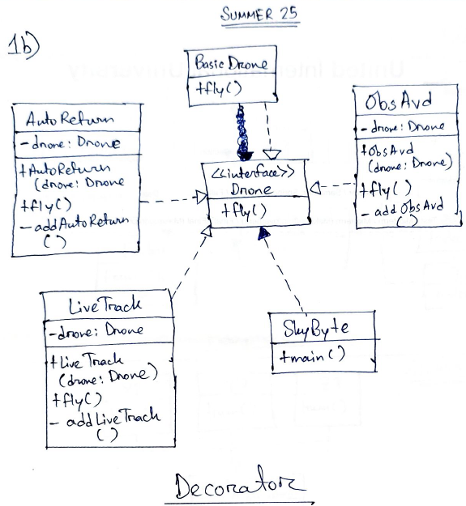
Summer 25

Slide 15
Spring 25
1. Design UML diagrams using the appropriate design pattern for the following scenarios: [CO2] [4 Marks]
(a) Tekno is a code editor that can compile and run codes for C, C++ and Java. Recently the developers at Tekno want to shift to Python as it is high on demand.

Slide 16
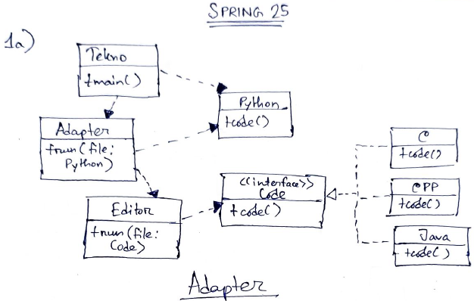
Spring 25

Slide 17
Spring 25
1. Design UML diagrams using the appropriate design pattern for the following scenarios: [CO2] [4 Marks]
(b) Tekno has a built in compiler system that optimizes compilation by using different algorithms for different programming languages. For C and C++, the compiler uses the X2 algorithm. For Java, Y7 algorithm is used. Z3 algorithm is applied for Python codes.

Slide 18
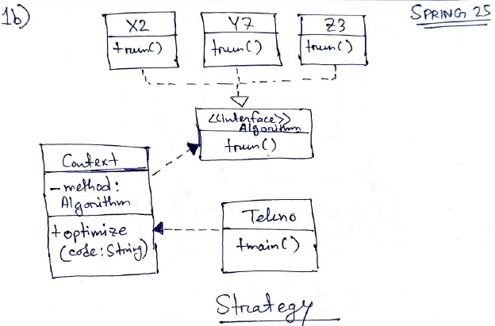
Spring 25

Slide 19
Fall 24
1a. Pookaburra is a cricket kit manufacturing company which produces the best quality cricketing equipments. They mainly produce bats, balls, and cricket gear. The raw materials required for the bats are wood(for the body) and rubber(for the grip). They produce two kinds of balls - white(for ODIs and T20s) and red(for Test cricket). The balls require wood and leather to produce. For gears, they mainly produce pads and helmets.
Draw an UML Diagram using an appropriate Design Pattern for the scenario above. [CO2] [5 Marks]

Slide 20
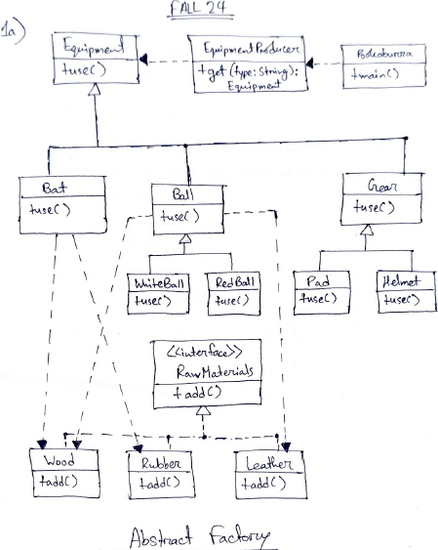
Fall 24

Slide 21
Summer 24
1a. TumTum Doughnuts is a leading doughnut chain that sells different varieties of doughnuts. You can buy two basic doughnuts - the disc-shaped doughnut and the ball doughnut. You can add different kinds of icing on the doughnut such as chocolate, strawberry and white-chocolate. You can also add fillings to the doughnuts such as custard, mousse and cheese. TumTum has recently introduced new toppings that can be added such as chocolate-shavings and cherry-fruit. A customer can order a plain doughnut, and if they want they can pick/not pick any one type of icing, filling and topping. Draw an UML Diagram using an appropriate Design Pattern for the scenario above. [CO2] [6 Marks]

Slide 22
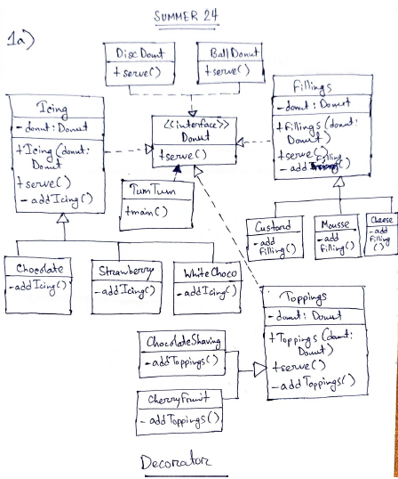
Summer 24

Slide 23
Spring 24
1a. Yummy is a fast-food chain restaurant serving the best dishes. They offer Burgers, Pizzas, and Drinks. There are two kinds of Burgers - Beef and Chicken. Pizzas come in 4 types - Alfredo, SMG, Cheezy, Mushroom. Soft Drinks (Coke, Dew, Sprite) and Shakes (Oreo, Kitkat) are available under Drinks.
Draw an UML diagram for the scenario above using the appropriate design pattern. [CO2] [4 Marks]

Slide 24
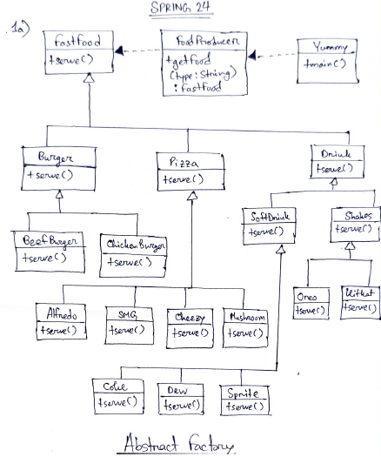
Spring 24

Slide 25
Spring 24
1b. Yummy is a fast-food chain restaurant serving the best dishes. They offer the customer’s to enjoy an open live kitchen and see their food being prepared. They cook their food either in the Skillet Grill, Tandoor Grill, Air Fryer according to the customer’s demand.
Draw an UML diagram for the scenario above using the appropriate design pattern. [CO2] [4 Marks]

Slide 26
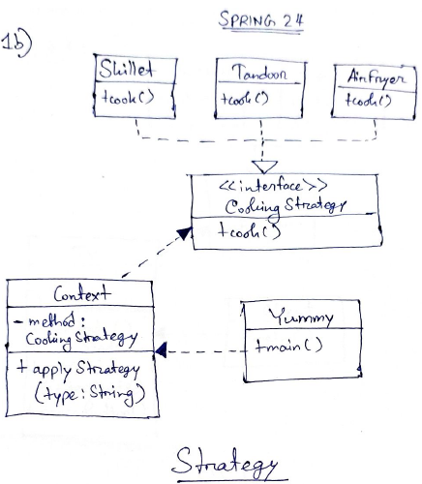
Spring 24

Slide 27
Fall 23
1. Part 1: [CO2] [4 Marks]
You’re a proprietor of a television manufacturing company. The television can only be in two modes: on, and off. It may go from on to off if the power button is pressed. It goes from off to on similarly. Follow an appropriate design pattern and draw an UML diagram for this scenario.

Slide 28
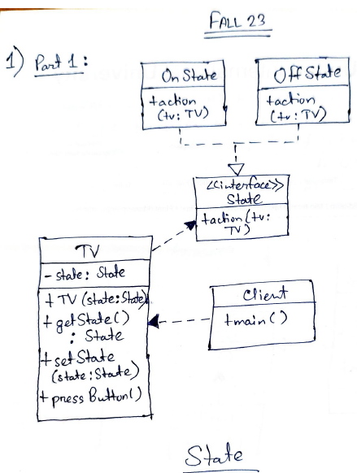
Fall 23

Slide 29
Fall 23
1. Part 2: [CO2] [4 Marks]
Later, you have decided to add surveillance mode (the front camera acts like a CCTV camera) and a constant-display mode (used to display some portraits letting the TV behave like wall art). These two features are independent and optional. You plan to add more features like these in the future. Which design pattern would you use to support this addition? Give e brief explanation.

Slide 30
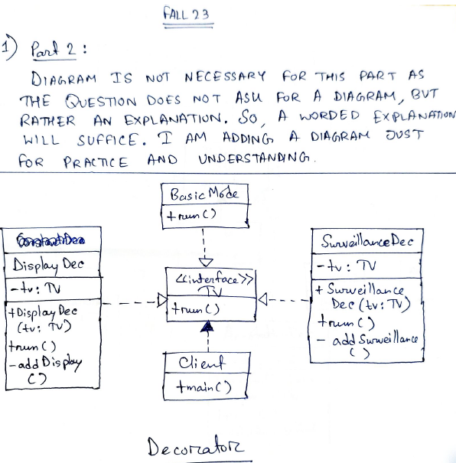
Fall 23

Slide 31
Summer 23
1. Draw an UML diagram for the following scenario:
[CO2] [8 Marks]
Visual Studio Code is an IDE which is used for writing and editing codes in different languages. The IDE supports programming languages such as C, Java, Python, and normal Text as well. It currently has different text styles such as Textual, Graphical and Colorful. The IDE supports themes such as Dracula and Heavenly. The Visual Studio Code team wants to add annotations to their codes such as Comments and Diagrams.

Slide 32
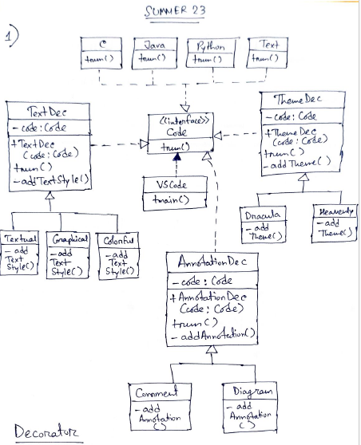
Summer 23

Slide 33
Spring 23 - MID
4. Draw an UML diagram for the given scenario using the appropriate design pattern: [CO2] [6 Marks]
Picasso is an art gallery company which creates different types of artwork. The three major artworks that are available in the company are Sketches, Portraits and Sculptures. Picasso provides multiple paint options such as Oil Paint, Pencils, Crayons. The paper options available are Art Paper, Canvass. Also multiple tools are available such as Brushes, Chisel and Hammer. Sketches are made on Art Paper with the help of Pencils and Crayons. Portraits require a Canvass, Brushes and Oil Paint. Sculptures need Marble and Chisel and Hammer to build.

Slide 34
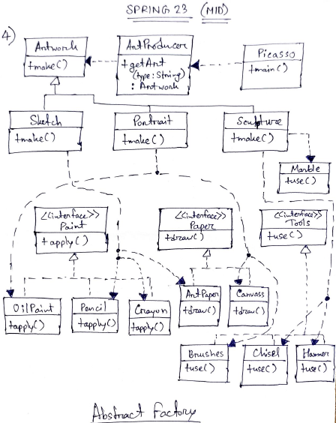
Spring 23 - MID

Slide 35
THANK YOU ^_^ !!!
BEST OF LUCK ^_^ !!!

